Slide 1
Good Morning
Take your name tag
Check-in

Slide 2




Data Analysis
Notes:
Today, we will cover
Talk about the progress of the project on Canvas
We have
Mid-semester Peer evaluation
Meeting with instructor
Presentation
Final Project Report
Peer evaluation
We will cover analysis until presentation day. SO if you need help with your analysis, I can help in in the optional project meeting. But besides that, I cannot walk through every group’s analysis

Slide 3


Inference – Statistics and Parameters
What do statistics measure?
What do parameters measure?
Notes:
Just a reminder,
What do statistic measure? Statistics measure the characteristics of a sample
What do parameters measure? Parameters measure the characteristics of a population

Slide 4
Statistics vs. Parameters
Statistics: values that are computed from information provided by a sample (e.g., sample average)
Parameters: values that are computed from a complete census which are considered to be precise and valid measures of the population (e.g., population average)
In other words, Parameters represent “what we wish to know” about a population. Statistics are used to estimate population parameters
Generalizing a Sample’s Findings to Its Population
Population
Sample
Notes:
This slide gives you a reminder on the definition of statistics and parameters.
Note: since we are interested in the population parameters (population mean from all the Mizzou students), we cannot use sample statistics directly (sample mean from a sample of Mizzou students),
We need to do some calculations, which will be covered in today’s lecture, to infer the population parameters by factoring in the uncertainty in our sample statistics.

Slide 5
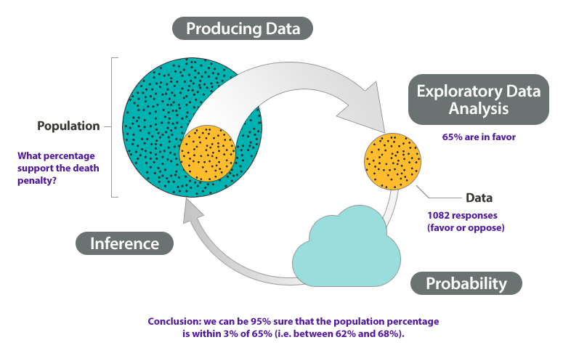
Statistical Inference
A set of procedures in which the sample size and sample statistics (e.g., sample average and sample standard deviation) are used to make estimates of population parameters
Notes:
this is study of statistics. Formally, statistical inference is a set of …
In this preliminary class, we can only cover so much. Hence, we have sample average and standard deviation. There are more sample statistics beyond these two, such as proportion.
Talk about the example

Slide 6
Parameter Estimation
What we know: sample statistics such as mean, mode, standard deviation, range etc.
The sample statistic may be either
Use sample statistics to infer about the population through confidence intervals
So what is confidence intervals?
a percentage, (i.e., 12% of the respondents stated they were “every likely” to patronize a new restaurant OR
a mean, i.e., the average amount spent per month in restaurants is $185
Notes:
We can know sample statistics such as mean, model, standard deviation, or range.
Typically, we cannot know the true range of the population,
However, with sample statistics such percentage or mean, we can infer mean and percentage for population parameters
Can someone quickly remind me when we use percentage and when we use mean?
Categorical: percentage
Continuous: mean
Going from sample statistics to population parameters, we have to quantify our uncertainty. Or in other words, we can quantify our confidence in having the true population parameters
That’s where confidence intervals come in.
Formally, it gives a range of values for an unknown parameter. The interval has an associated confidence level chosen by the investigator. We will talk more about this with its formula.

Slide 7
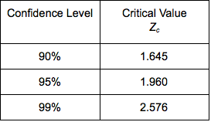
Parameter Estimation
Confidence Interval:
Mean: $\overline{x}±t_{\left\{critical\right\}} ∗SE$
Mean: 𝑥 ̅±𝑡_{𝑐𝑟𝑖𝑡𝑖𝑐𝑎𝑙} ∗𝑆𝐸
Standard error = $\frac{SD}{√n}$
Standard error = 𝑆𝐷/(√𝑛)
Proportion: $p±t_{critical} ∗SE$
Proportion: 𝑝±𝑡_𝑐𝑟𝑖𝑡𝑖𝑐𝑎𝑙 ∗𝑆𝐸
Standard error = $√(p∗q/n)$ where p = 1- q
Standard error = √(𝑝∗𝑞/𝑛) where p = 1- q
This Photo by Unknown Author is licensed under CC BY
Notes:
This is the formula to calculate the confidence interval for mean and proportion.
As mentioned in the last slide, mean is used for continuous variables, while proportion is used for categorial variables
You need to be careful to choose the type of descriptive statistics that you want to report.
After you have your formula, you also have to decide at what level of confidence do you want to calculate
I think most of you have seen this table of translation between confidence and critical value of Z, or t
Because t with large sample resemble z distribution
In this sense, we might use the two interchangeably in some cases. But you should know the difference
We will go into examples in excel. (confidence interval file) and also the excel help sheet
And also in R
https://rstudio.cloud/project/2980145

Slide 8
Example 1
Those who dine out on Wednesday’s, spend on an average $45.2, SD = 20, n = 500, 95% confidence (t = 1.96)
Notes:
Formula:
For percentage, p + t*SE, p – t*SE
For mean, xbar + t*SE, xbar – t*SE
p is the sample percent. xbar is the sample mean.
SE: standard error
For percentage: square root (p*q/n) note: p = 1-q
For mean: SD/square root(n) note: SD is standard deviation
t value @ difference confidence level: @90%: 1.65 @95%: 1.96 @99%: 2.58
Question: a) why do we need confidence interval? why can’t we just use the descriptive statistics - mean or percent?

Slide 9
Answers
Compute Confidence Intervals
Mean = 45.2, SD = 20, n = 500
[45.2 +/- 1.96*20/SQRT(500)]
$43.45 - $46.95
Conclusion:
We are 95% confident that in population the people who dine out on Wednesday spend between $43.45 to $46.95

Slide 10
Example 2
30% people say they dine out on Wednesday’s, n =500, 95% confidence (i.e., t = 1.96)
Notes:
Formula:
For percentage, p + t*SE, p – t*SE
For mean, xbar + t*SE, xbar – t*SE
p is the sample percent. xbar is the sample mean.
SE: standard error
For percentage: square root (p*q/n) note: p = 1-q
For mean:SD/square root(n) note: SD is standard deviation
t value @ difference confidence level: @90%: 1.65 @95%: 1.96 @99%: 2.58
Question: a) why do we need confidence interval? why can’t we just use the descriptive statistics - mean or percent?

Slide 11
Answer
Compute Confidence Intervals
p = 30%,n =1,000, t=1.96
26.0% -34.0%
[30-1.96*SQRT(30*70/500), 30+1.96*SQRT(30*70/500)]
Conclusion:
We are 95% confident that in population, 26% to 34% of people dine out on Wednesday.

Slide 12
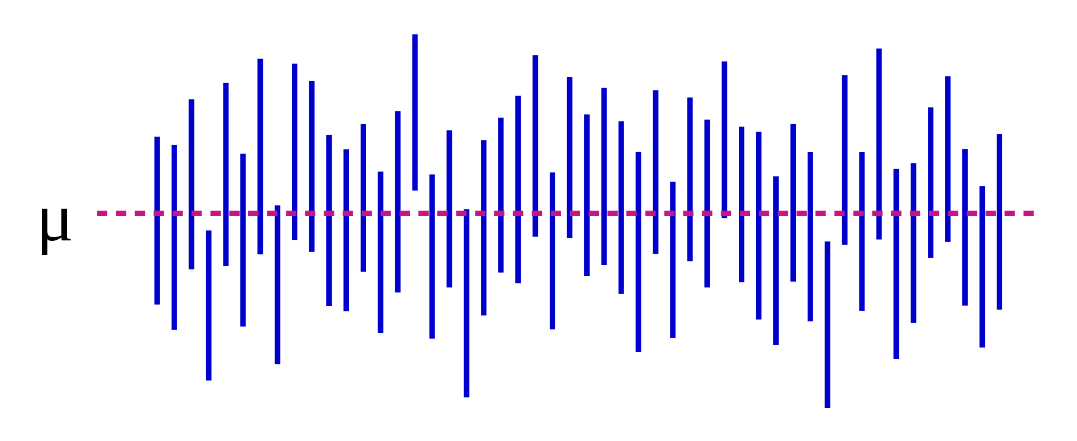
Confidence Interval Visualization
This Photo by Unknown Author is licensed under CC BY-SA
Notes:
Explain this plot
Note: 95% confidence in math means we draw 100 samples, 95% of the sample average will fall within the range.

Slide 13
Parameter Estimation
What does confidence level mean?
It means that we can say that if we did our study over 100 times (although we only did ONCE), we can determine a range within which the sample statistic will fall 95 times out of 100 (95% level of confidence). This gives us confidence that the real population value falls within this range
100 times, ($32, $35) $33.5

Slide 14
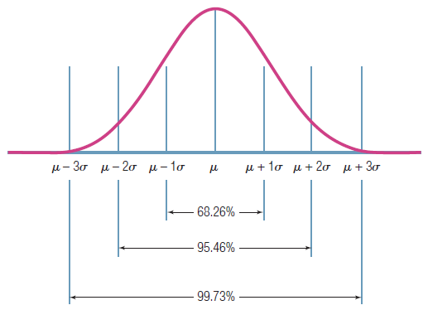
Confidence level visualization – increase the confidence level, the interval will be widened
95% confidence level covers the 95% of sample mean if we keep drawing the samples from the population randomly
Notes:
Sigma here stands for the population average standard deviation – it is calculated by the sample SE = SD/SQRT(n)
mu is the population average. sigma is the population variation.

Slide 15
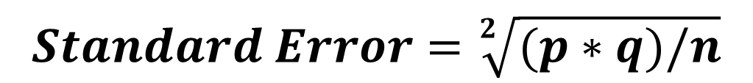

Parameter Estimation
If we have percentage,
If we have mean,
Given the same sample size, the more variability, the __ the standard error.
The lower the standard error, the __ precisely our sample statistic will represent the population parameter
Notes:
Given the same sample size, the more ….
So we here we have seen standard error and standard deviation, can you tell me what the difference between the two?

Slide 16
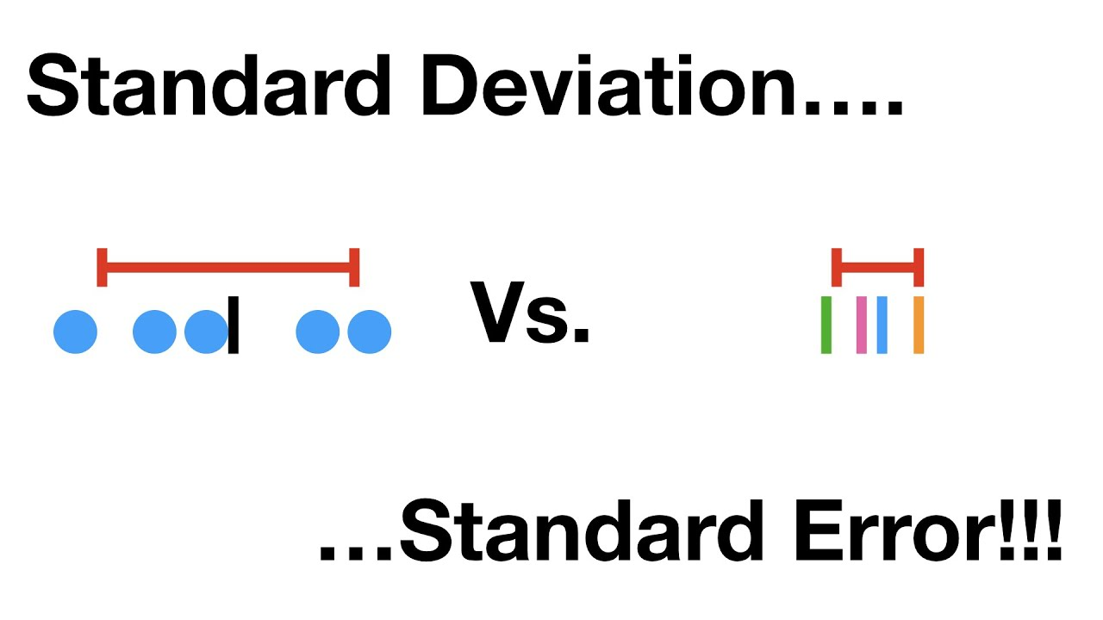
Difference between SE and SD
The standard deviation (SD) measures the amount of variability, or dispersion, from the individual data values to the mean,
The standard error of the mean (SEM) measures how far the sample mean (average) of the data is likely to be from the true population mean.
Notes:
Reminder
Note the SD (standard deviation) and SE (standard error) are different in formula.
The standard deviation (SD) measures the amount of variability, or dispersion, from the individual data values to the mean, while the standard error of the mean (SEM) measures how far the sample mean (average) of the data is likely to be from the true population mean.

Slide 17
Chapter 20: The Written Research Report
Notes:
Now, we will cover chapter 20 which I’ll say less cognitively demanding

Slide 18
Learning Objectives
Discuss three writing standards that a report should meet if it is to communicate effectively with readers
Outline the main elements that make up a standard research report
Explain the kind of info contained in the executive summary
Notes:
These are overall learning objectives

Slide 19
The Written Research Report
Research reports are evaluated based on one fundamental issue: How well do they communicate with the reader?
Near-perfect research can get lost in the clutter of a poorly written report
Notes:
Written report is all about how you communicate your result with your audience. Even if you run all kinds of fancy tests, if you cannot relay the results or be able to interpret and communicate them with your boss. Then, you can appear like you did nothing right?
A near-perfect …

Slide 20
The Paradox of Completeness
Completeness: The degree to which the report provides all the info readers need in langue they understand
A written report must be complete… without being too complete. The trick is to determine what really matters and what ought to be shifted to an appendix or left out entirely (caution).
Notes:
However, there is also the paradox of completeness
People who are involved in the analysis process usually want to be as complete as possible because they have done so much works that they want to show off how much work they have done. However, they can also run the risk of being too complete, that might stray their audience from the important message or takeaways.
On the other hand, people can also be deceiving that they can strategically omit stuffs, tests that did not fall into their prediction can be an example. In this case, you as co-workers or co-researchers need to step up and encourage completeness.
Strategic omission.

Slide 21
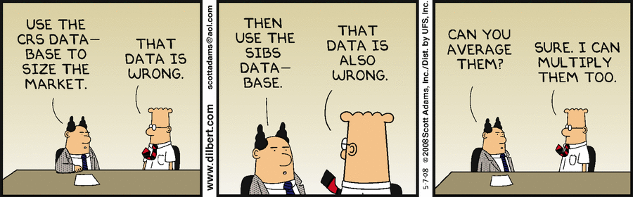
Accuracy
The degree to which the reasoning in the report is logical and the information correct
This Photo by Unknown Author is licensed under CC BY-SA
Notes:
You just don’t want to be deceiving or report incorrect information.
If you have two wrong datasets or data analyses, it doesn’t mean after averaging them you have a correct one.

Slide 22
Examples of Inaccuracy
Inaccuracy | Example
Simple Errors in Addition or Subtraction | “In the US, 14% of the population ahs an elementary school education or less, 51% has attended or graduated form high school, and 16 has attended college.”
Confusion between percentages and Percentage Points | “The company’s profits as a percentage of sales were 6% in 1997 and 8% in 20002. Therefore, they increased only 2% in five years.”
Inaccuracy Caused by Grammatical Errors | “The reduction in the government’s price supports for diary products has reduced farm income from $600 million to $800 million per year.”
Confused Terminology Resulting in Faulty Conclusions | “The Jones’ household annual income increased from $15,000 in 1976 to $45,000 in 2006, thereby tripling the family’s purchasing power.”
Notes:
These are examples of inaccuracy
Read them

Slide 23

Clarity
The degree to which the phrasing in the report is precise
Notes:
You also want clarity in your report. It just means you need to clearly communicate the results and the next step to your managers.

Slide 24

How to Achieve Clarity
Carefully organize your report
Write in short sentences and paragraphs
Write… rewrite… and rewrite again
Shorten the report until every word has purpose
Notes:
Clarity can be achieved by

Slide 25
Written Research Report Outline
Completeness must be balanced against Clarity

Slide 26
Written Research Report Outline
Exhibit 20.2 Written Research Report Outline
Title page
Table of contents
Executive summary
Introduction
Method
Results
Research Findings
Limitations
Conclusions and recommendations
Appendices
Copies of data collection forms
Data collection forms with univariate results
Codebook
Technical appendix (if necessary)
Exhibits not included in the body (if necessary)
Data file for archival storage
Bibliography
Notes:
Here is a formal written research report outline. You can review these slides later.
However, in this class I do not need you to write pages long of report.
If you can open an example of final report examples. We can go over my expectation together
Report Guidline: https://github.com/mikenguyen13/mar4050_F21/blob/master/project_assignment/written_report/Project%20Report%20Guideline.pdf
Example: https://github.com/mikenguyen13/mar4050_F21/blob/master/project_assignment/written_report/example1%20SlideDoc%20research%20report.pdf

Slide 27
Executive Summary
The executive summary is the most important part of the report
Think about what you would most want to communicate about he project if you only had 60 seconds to do so.
Introduction
Results
Conclusions
Recommendations

Slide 28
Introduction
The introduction sets up the project by providing background for the project and specifying the decision problem and research problem(s)

Slide 29
Method
This section is important – and difficult to handle well. You need to provide enough detail so that readers know how you conducted the research but not so much detail that they get lost and lose sight of the bigger story you are telling in the report.

Slide 30
Results
The results section should be organized to provide answers to the research problem(s) that motivated the project
Because no projects are perfect, be sure to include a limitation section. This often adds credibility to the overall project.
Tables and figures are encouraged IF they help communicate answers to research problems. Place them in the results section to illustrate the key findings.
All other exhibits should probably be placed in an appendix and referenced in the text as needed.

Slide 31
Conclusions and Recommendations
There should be a conclusion for each of the research problems that motivated the study
Researchers' recommendations about what to do next based on the research findings follow the conclusions

Slide 32
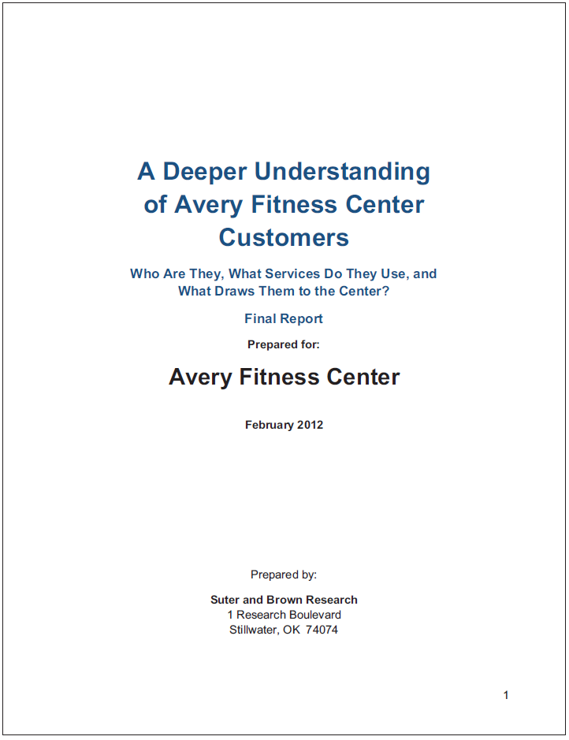
Appendices
The research report provides an archive of the project. Here are some things that should be included:
Copies of data collection forms
Univariate results and/or data tables (often placed on the data collection form)
Codebook
Technical appendix or any additional exhibits not included in results (if needed)
Data file
Bibliography

Slide 33
Data Analysis Plan Template Assignment 6
 |  | Data Analysis Plans
(1) | (2) | (3) | (4) | (5) and (6)
Research Question | Type of Research Question* | Questionnaire Question | Level of Measurement** | Descriptive statistics or Statistical Test
* descriptive or differences research question
** nominal, ordinal, interval, or ratio
Notes:
Go to assignment 6
https://umsystem.instructure.com/courses/41919/assignments/871304?module_item_id=2985137
Show template
And go through example with students

Slide 34
15-min Group Discussion
Sign up for presentation day (same link for the project meeting)
Each team will present 15 mins and 5 mins Q&A
Not all group members need to present (As long as your group finds optimal task allocation).
Discuss questions that allow you to use descriptive statistics (e.g., mean, prop, confidence interval)

Slide 35
Up next
Visualization and Presentation
PA #6: Data Analysis Plan

